Slide 1
Threading Part 3
CS221 – 4/24/09

Slide 2
Teacher Survey
Fill out the survey in next week’s lab
You will be asked to assess:
The Course
The Teacher
The TA
To login you’ll only need your last name and banner ID

Slide 3
Where We Left Off
Data integrity options:
Synchronized methods
Synchronized statements using locks
Atomic data access
Immutable objects
Order of operations options:
Guarded blocks
Locks

Slide 4
Atomic Variables
The problem:
We want C++ to be atomic
We don’t want to block other threads with synchronized method or statement
Volatile doesn’t work except in the simplest scenarios
The solution:
Atomic Variable

Slide 5
Atomic Variables
Look in Java.Util.Concurrent.Atomic
Note there are a variety of atomic types:
Boolean
Integer
IntegerArray
Long
LongArray
Etc.

Slide 6
Atomic Variables
Atomic variables support lock-free thread-safe data access and modification.
Basically these are volatile + they support get and update atomically
On increment and decrement, Volatile failed us
Atomic variables should solve the problem

Slide 7
Example
Let’s look at Volatile vs. Synchronized vs. AtomicInteger

Slide 8
Immutable Objects
An immutable object cannot be changed once it is constructed
Examples
String class
Integer class
Immutable objects are automatically thread-safe

Slide 9
Immutable Objects
In order to change an immutable object
Create a new instance
Copy the new value into the new instance
GC eventually cleans up the old instance

Slide 10
Immutable Objects
Pros
Don’t have the overhead of thread synchronization. Improved performance, reduced complexity
Generally simple and robust
Cons
If it changes you need to create a new instance. Minor performance impact.
Not a good choice for storing sensitive data

Slide 11
How to Create an Immutable Class
Don’t provide setter methods
Make all fields final and private
Don’t allow subclasses to override methods
E.g. Make the class final
Don’t provide any methods that modify mutable objects
Don’t pass references to mutable objects back to the caller

Slide 12
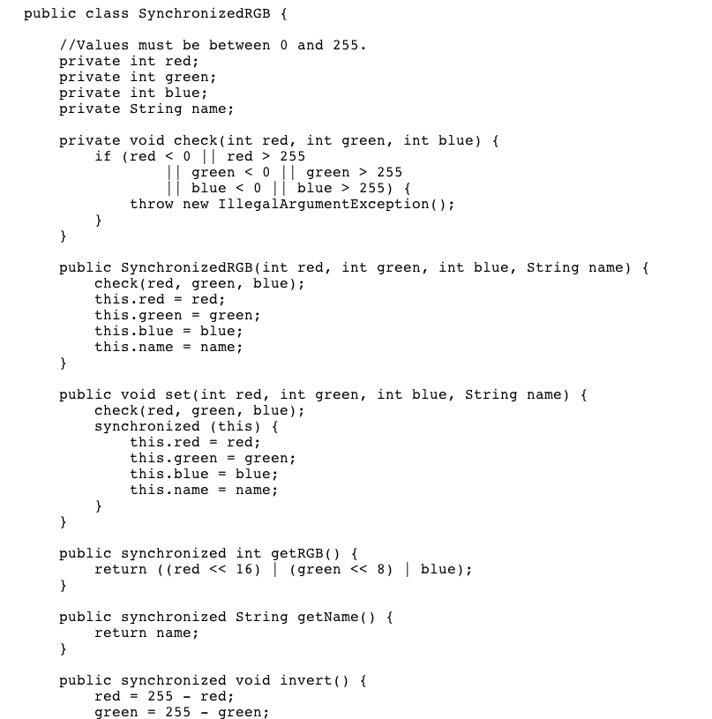
Example

Slide 13
Multi-threaded Problems
Looking at this code…
…what problems can you foresee?

Slide 14
Multi-threaded Problems
Thread 1:
Color color(255, 255, 255, “White”);
int myColorInt = color.getRGB();
String myColorName = color.getName();
Thread 2:
color.set(0, 0, 0, “Black”);

Slide 15
Convert to Immutable
There are two setters in the class
Set()
Invert()
Remove Set, no need in an immutable class
Change Invert to return a copy

Slide 16
Convert to Immutable
There are a set of private fields
Make them final as well

Slide 17
Convert to Immutable
We want to make sure the class can’t be overridden
Make the class final

Slide 18
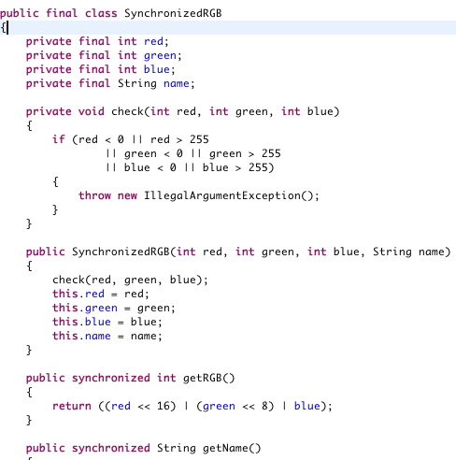
Immutable RGB

Slide 19
Thread Synchronization
So far we’ve talked about ways to protect data integrity
What if you want to ensure correct order of operations?
E.g. Thread 1 cannot do X until Thread 2 does Y

Slide 20
Producer-Consumer Problem
Producer-Consumer is an example where order of operation thread synchronization is important
This is a classic multi-threaded synchronization problem
Imagine two threads:
Producer, creates data
Consumer, does something with that data

Slide 21
Producer-Consumer Problem
Furthermore:
Producer and consumer share a fixed size buffer
Producer generates a piece of data, sticks it in the buffer, repeats
Consumer pulls one piece of data at a time from the buffer
Producer shouldn’t try to add if the buffer is full
Consumer should try to remove from the buffer if it is empty

Slide 22
Producer-Consumer Problem
Therefore:
Producer should sleep if the buffer is full and only wake up after consumer has removed an item
Consumer should sleep if the buffer is empty and only wake up after the producer has added an item

Slide 23
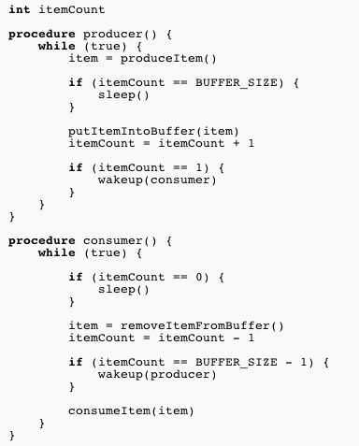
Simple Solution

Slide 24
What’s the Problem?

Slide 25
The Problem
Consumer notices there are no items and sleeps
Producer adds an item and wakes up the consumer
The consumer is not yet fully asleep so the wakeup call is lost
Result is Deadlock!
Consumer sleeps forever
Producer fills the buffer and then sleeps forever

Slide 26
Liveness
This is the problem of liveness
It is the classic problem of thread run-time synchronization
How do you coordinate two threads without getting stuck?

Slide 27
Liveness Problems
Can be broken into three categories:
Deadlock
Starvation
Livelock

Slide 28
Deadlock
Two or more threads are blocked on each other, waiting forever.

Slide 29
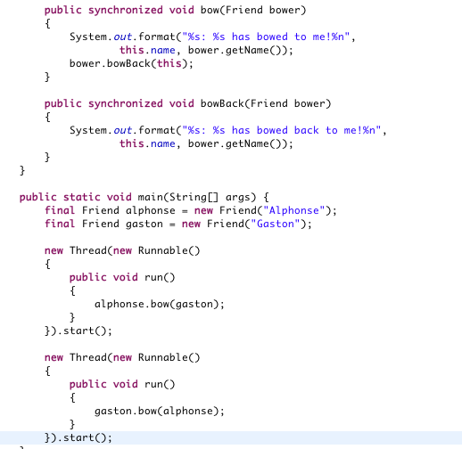
Example

Slide 30
Starvation
A thread needs access to a resource but cannot get it for long periods of time
Caused by a greedy thread which blocks other threads access to the resource
For instance
Imagine a synchronized method that is very slow to return
Thread 1 calls this method often
Thread 2, when calling the method, will often be blocked

Slide 31
Livelock
Thread 1 takes action in response to Thread 2
Thread 2 takes action in response to Thread 1
Threads aren’t blocked but they are in an endless loop of responses and won’t do other work.

Slide 32
Livelock Example
Alphonse moves to his left to let Gaston pass, while Gaston moves to his right to let Alphonse pass. Seeing that they are still blocking each other, Alphone moves to his right, while Gaston moves to his left. They're still blocking each other, so...

Slide 33
Guarded Blocks
In order to coordinate activity between two threads we can use Guarded Blocks
Wait() – puts a thread to sleep until it is notifie
Notify() – wakes up one thread that is waiting on this object
NotifyAll() – wakes up all threads waiting on this object

Slide 34
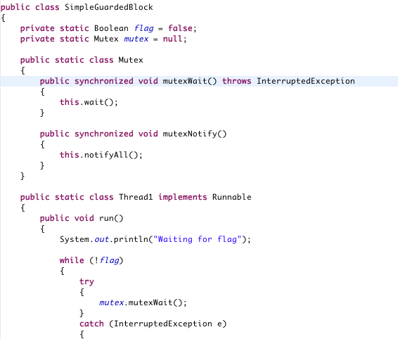
Guarded Blocks Example

Slide 35
Fixing the Deadlock
How would we fix the earlier bowing deadlock?

Slide 36
Producer-Consumer Example
Let’s look at a more complex example
Remember the producer-consumer scenario?
Our implementation is inefficient. Why?
How do we improve it?

Slide 37
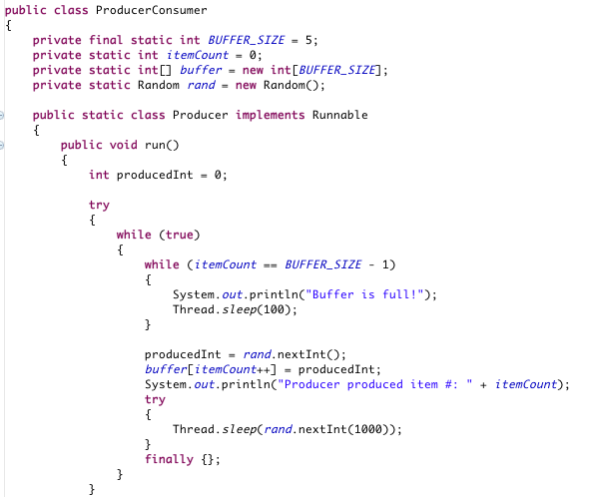
Producer-Consumer Example

Slide 38
